Slide 1
Emerging Skills in the Semiconductor Industry
People Analytics Case Study | Jessica Le

Slide 2
Objective & Process
Identify emerging skills in the semiconductor industry
Inform future hiring & workforce development strategies
Data Collection
Identifying Emerging Skills
Key Insights & Recommendation

Slide 3
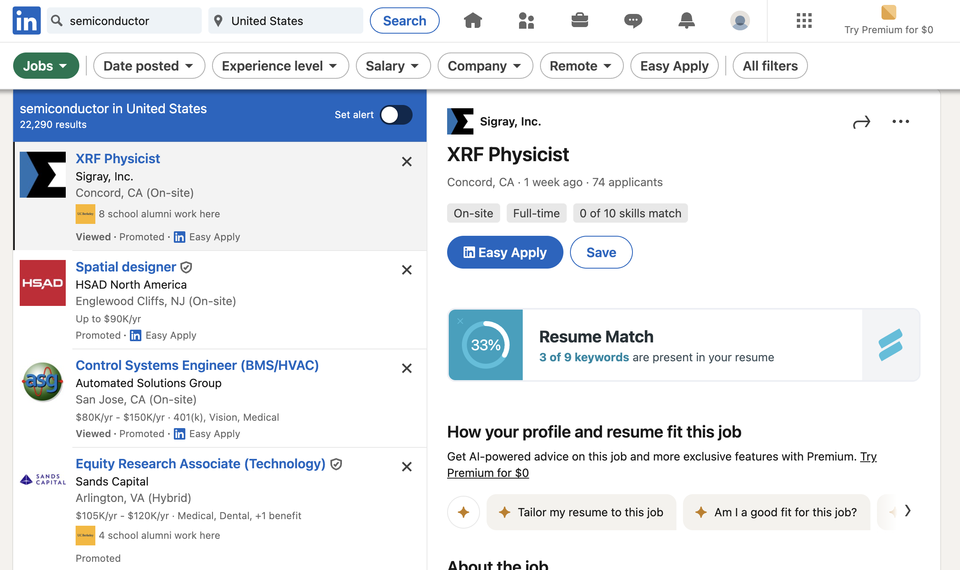
Web scraping job listings from LinkedIn
Tools: Python, Selenium, WebDriver Manager
Process:
Log in to LinkedIn (using automation)
Search for "Semiconductor" jobs
Extract job details: title, company, location, description, etc.
Save all listings into a CSV file

Slide 4
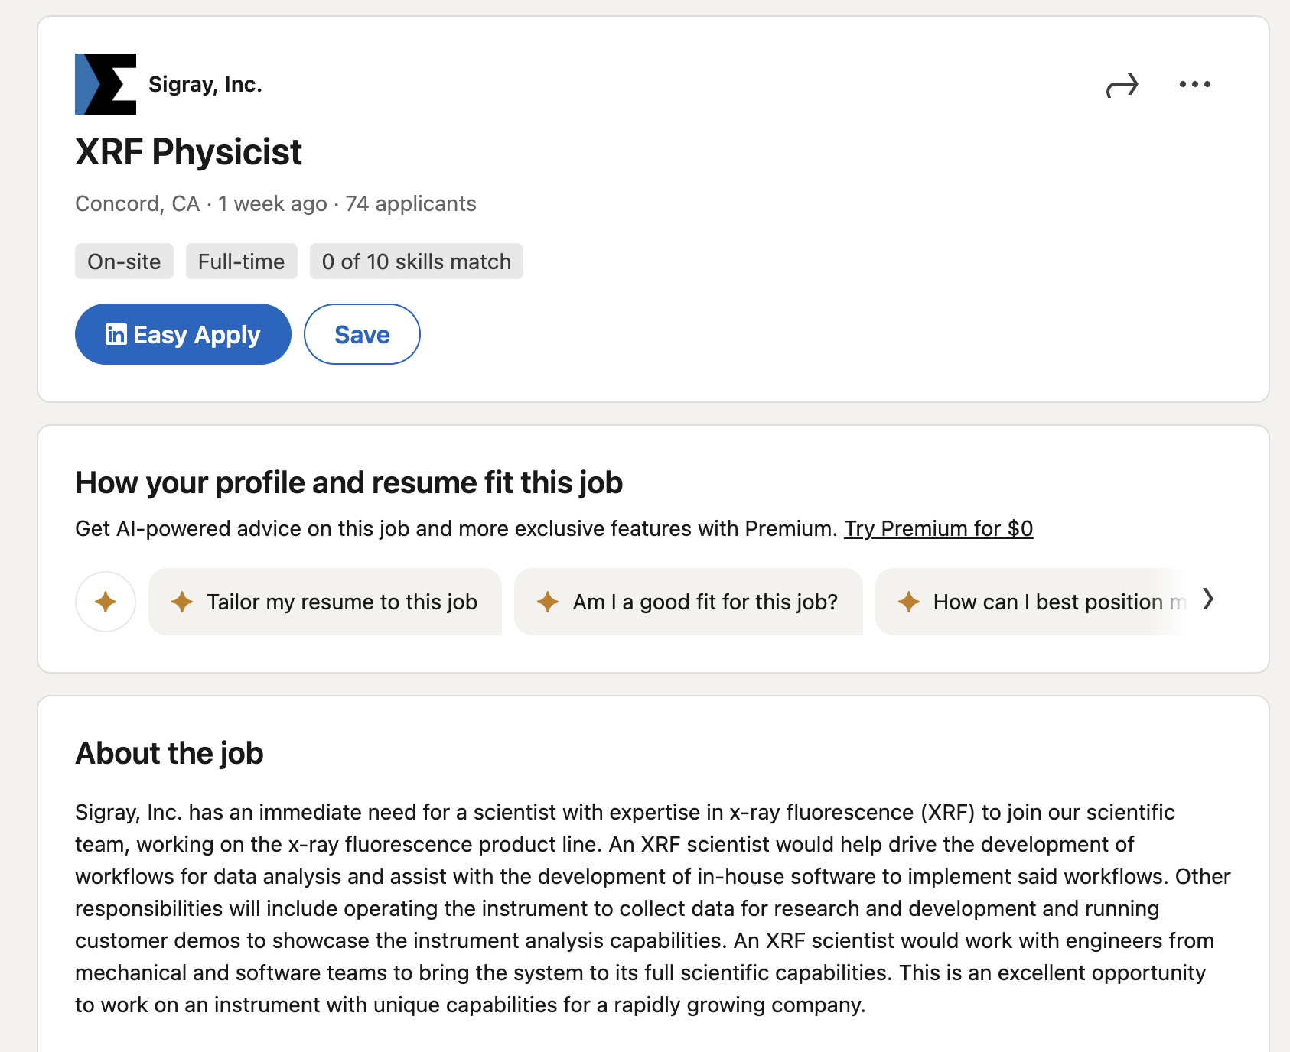
Output: job listings with job title, company, location, date posted and descriptions
linkedin_url | job_title | company | location | posted_date | Job _ description
https://www.linkedin.com/jobs/view/4138270054/?eBP=CwEAAAGWCCaJNqwyV9ujd5W_p-yDBPJMSIY59Rq0ckd1pObbaSpdPJaqX8QMo9rOggY438oPvvevXT_qHJ40s8gMef8fGfp_EvXGAkVVRvdIGsO3tZHRY1Y9Ap8-USWu66eOtIqdQ4IpXjyDIaJbIuE956V1uy3yGpL2gDVCdUka-M6Q1Bq0s-553Hnp5cKsfwO6ti3FyqFAOgeK_r3qXuWWNn1PApCRNwccmDevPIki4wrhmg5GkfLgIB-1bZLKHnXarTN7YlDeZIcrl-LvgB4fxFVyBo7L3tZE1fOCU2d6O-tWP5JSOrwd_XvUz9f8zEqcGym0sg2E4r2toyL9L6aNcQTMkFVXzjm8FO43euyeJr8Yjsv7U8io-zzSrvgjTjHkz_othHYo11bXcFugSo2SXIQg8ZUI81JMQS8AvpD25Y8szQllTzNXwKK_NEq4MYGAVSKjCOFxIic6oXryp7Zt02v5T37C6N1nOGRynbNX_q60rxJy-rQtkOnBb16I5rIPUs8UO4j6&refId=xHHqbQMRtLO8gVk4Eu1%2BLw%3D%3D&trackingId=2L4EEv4hdVVHShpJdiit%2Bg%3D%3D&trk=flagship3_search_srp_jobs | Thin Film Solution Processing Technician | Tandem PV | San Jose, CA | 1 day ago | About the job At Tandem PV we are a team of people who are passionate about building a more sustainable world by bringing more cost effective solar panels onto the market. We’re scaling metal-halide perovskite solar technology to make best-in-class mechanically stacked tandem modules. We have built efficient, durable cells, monolithic multi-cell submodules, and packaged modules with our scalable, low-cost process. Our next focus is expanding our team and building a pilot manufacturing facility. Sounds like a lot, right? It is, and that’s why we need you to join the team! In this critical role, you will work closely with a team of engineers and technicians in our R&D laboratory to execute and develop thin film solution deposition processes. You will interface directly with your colleagues on other teams to develop and execute experimental plans to develop perovskite solar modules. To Be Great At This Role, You Will Have A can-do attitude: To be a bit corny, you blaze a trail where there is none, rather than identify obstacles for others to clear. Comfort with uncertainty: You will often be operating in an environment requiring autonomy in judgment and action, and will need to identify, communicate, and execute on a plan and report when you identify issues. Flexibility: You have broad capabilities in the laboratory and can flex in several directions (at once, if need be) to solve multifaceted problems that defy disciplinary boundaries. An interest in learning: If you don’t know anything about our product, but want to live in a better world and are willing to learn from your coworkers and independently, we may have a place for you. A goal-oriented mindset: You come to work to achieve objectives, not check off items on a list. You’re focused on getting your work product past the goalpost, and you don’t put it down until you’ve done that. Pride in your work: You clean up after yourself; you take an extra few minutes to label or tidy or otherwise organize your space; you want to “do it right.” Communication skills: You can clearly communicate about what you did in the lab, or you can give a headline because your colleague is in a hurry. You are comfortable presenting to a group; you can balance frankness with tact and kindness. Qualifications We can teach a lot, but there are some basics you’ll need to know to hit the ground running, that includes: Work experience that shows you are willing to push projects forward and work as a team to accomplish goals. Work in a scientific or engineering related industry with experience with solution processing of semiconductor thin films would be ideal, but not a requirement. Hands-on laboratory experience is a plus. Able to take detailed and meticulous notes of processing conditions and observations when running experiments and processes. Driven to accomplish tasks towards producing solar modules and progressing as a larger team to make the high performing and durable perovskite modules. What We Offer An awesome team of dedicated technologists changing the way the world is powered! If that’s not enough, we’ll take good care of you and your family with: Flexible PTO Healthcare coverage Life Insurance Long-term & Short-term Disability Parental leave Meaningful equity Tandem PV uses perovskite & silicon mechanically-stacked tandems to upgrade silicon solar panels, sharply decreasing installed systems costs, significantly increasing module manufacturing profit margins, and opening up vast new solar markets in the US and worldwide. TPV was co-founded by Stanford PhDs Colin Bailie and Chris Eberspacher; is advised by industry experts from Corning, First Solar, Vivint Solar, and Kateeva; has raised more than $50M in Series A funding. We were recently recognized as the Best Pre-Commercial Venture of 2025 by the Industry Growth Forum (IGF) We are a team of people who are passionate about building a more sustainable world by delivering a new generation of solar panels to the market. We are constantly growing and are always looking for dedicated, hardworking, and empathetic teammates. Tandem PV is a diverse, equal opportunity employer. All qualified applicants are encouraged to apply. See less
https://www.linkedin.com/jobs/view/4195980509/?eBP=CwEAAAGWCCaJNvcKbQmRr85f_t5LGm5JgdAxfhngNSxdMWB58a09Js015MIGmdMAuCt5bh8qBp-BYP30lrmvbUfAWOq9eQvteL38Bxe4VQQwUgDlV2uAuLN0UuppZfqN5ABt928e4uNgdXQu1CgSpU_ZmyMcs5EZ6XTl481euALbtblWGFJdY-V31SM09iuxLVS6UlQJawGe9CZ8gE_J-oXZct6S6k-g2ecnFcmDbUecHqt2-tyONLSnbe2OtdQe7r7hGsYwJt0LcGDvxomT6llMo9PNmGFPJIju-X6UoUup3aNy7oFXm3Ew10tNG8Mwx3JEnS-msnNdQhNoXmqU5ilPFd6DK53MMAkwADhx703fZv2XyPerdiuSlzMcJCNBUexK_5S09VPwx6cgn5S4xBUboF_XpWyUuCzBpCIw7CAEuRgfuynefWoAzBh1_Vmh_WY9XqFUvI1TYVis3F8qD-6i&refId=xHHqbQMRtLO8gVk4Eu1%2BLw%3D%3D&trackingId=0HyKC7BI7H2Aww8Cc2OMlw%3D%3D&trk=flagship3_search_srp_jobs | 2025 Summer Technical Communication Intern | INFICON | New York, NY | 1 week ago | About the job Company Description INFICON is a leading provider of innovative instrumentation, critical sensor technologies, and Smart Manufacturing/Industry 4.0 software solutions that enhance productivity and quality of tools, processes, and complete factories. These analysis, measurement and control products are essential for gas leak detection in air conditioning/refrigeration and automotive manufacturing. They are vital to equipment manufacturers and end-users in the complex fabrication of semiconductors and thin film coatings for optics, flat panel displays, solar cells and industrial vacuum coating applications. Other users of our vacuum-based processes include the life sciences, research, aerospace, packaging, heat treatment, laser cutting and many other industrial processes. We also leverage our expertise in vacuum technology to provide unique, toxic chemical analysis products for emergency response, security, and environmental health and safety. Responsibilities Job Description Write clear and concise technical documentation for use by the Applications Support Team and FabGuard Customers Refactor existing content to align with current industry standards and Inficon IMS TC Standards Assist IMS Product Owners in transferring and organizing content for effective versioning Collaborate with subject matter experts to gather and understand complex technical information Update user manuals, online help systems, and other user-facing documentation Develop and maintain a consistent writing style and terminology across all documentation Participate in document review processes and incorporate feedback from team members Assist in the creation and maintenance of technical glossaries and style guides Contribute to the improvement of documentation processes and tools Learn and apply best practices in technical writing and information architecture Assist in the creation of visual aids such as diagrams, screenshots, and flowcharts to enhance documentation Qualifications Pursuing a bachelor’s degree in computer science, engineering, chemical engineering, or related field is required Additional Information The expected salary range for this position is between $18.00 and $26.00 per hour. The actual compensation will be determined based on experience, location, and other factors permitted by law. INFICON provides a dynamic work environment that promotes diversity, equity, and inclusion. Our employees experience ongoing green initiatives, flexible work hours, and a variety of health and wellness programs. Explore abundant growth opportunities and enhance your skill set with INFICON's innovative mindset. Join our dynamic work atmosphere, which features competitive compensation, potential relocation support, and extra perks such as comprehensive medical coverage, sick time, and more! Selected candidates must have reliable transportation, as our facility is not conveniently located near a bus route. INFICON is committed to ensuring that our online application process provides an equal opportunity to all job seekers that apply without regard to race, religion, ethnicity, national origin, citizenship, gender, age, protected veteran status, disability status, genetic information, sexual orientation, or any other protected characteristic. A notice describing Federal equal employment opportunity laws is available here to reaffirm this commitment. Any contact that would like to request a reasonable accommodation to participate in the application process should contact us.careers@inficon.com. INFICON, Inc. strictly complies with all aspects of the Export Administration Regulations ('EAR'), including those sections dealing with deemed exports to foreign nationals. See less

Slide 5
Data Cleaning & Text Preprocessing
Filled missing values
Removed duplicated/incomplete/irrelevant job titles
Standardized dates to YYYY-MM
Tokenization
Stopword removal (including domain-specific ones)
Lemmatization

Slide 6
Technical Skills Dictionary & Skill Extraction
~300+ curated skills
Categories: programming, hardware, verification, manufacturing, etc.
Multi-word skills prioritized
Phrase matching
Token matching
Top 10–20 skills extracted

Slide 7
Topic Modeling
LDA, NMF, K-Means
Each identifies topics/skill clusters
5 topics each

Slide 8
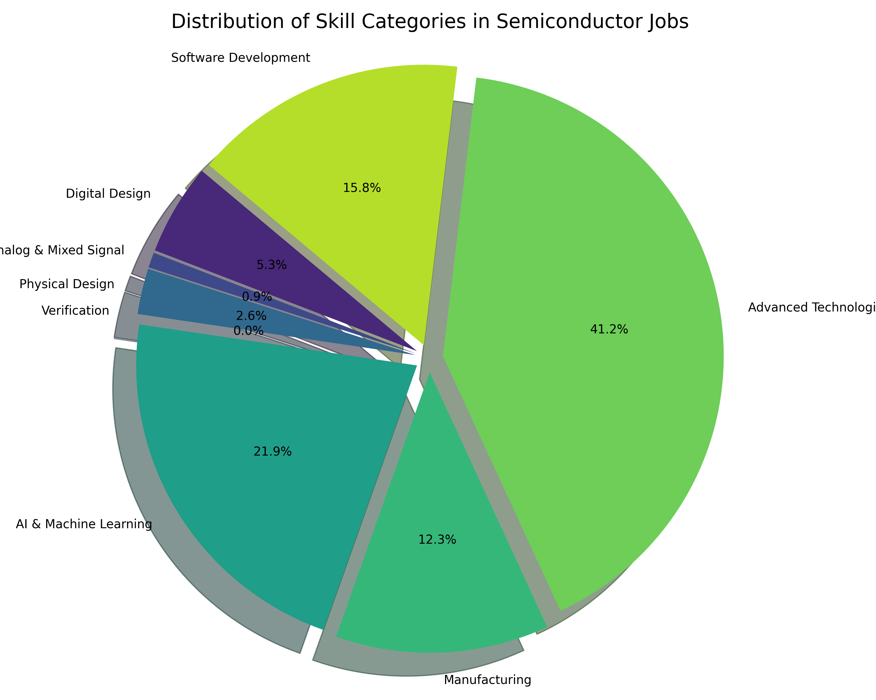
Skill Categories Visualization
Pie chart of skill domains (e.g., AI, design, software)
Title-based skill heatmaps

Slide 9
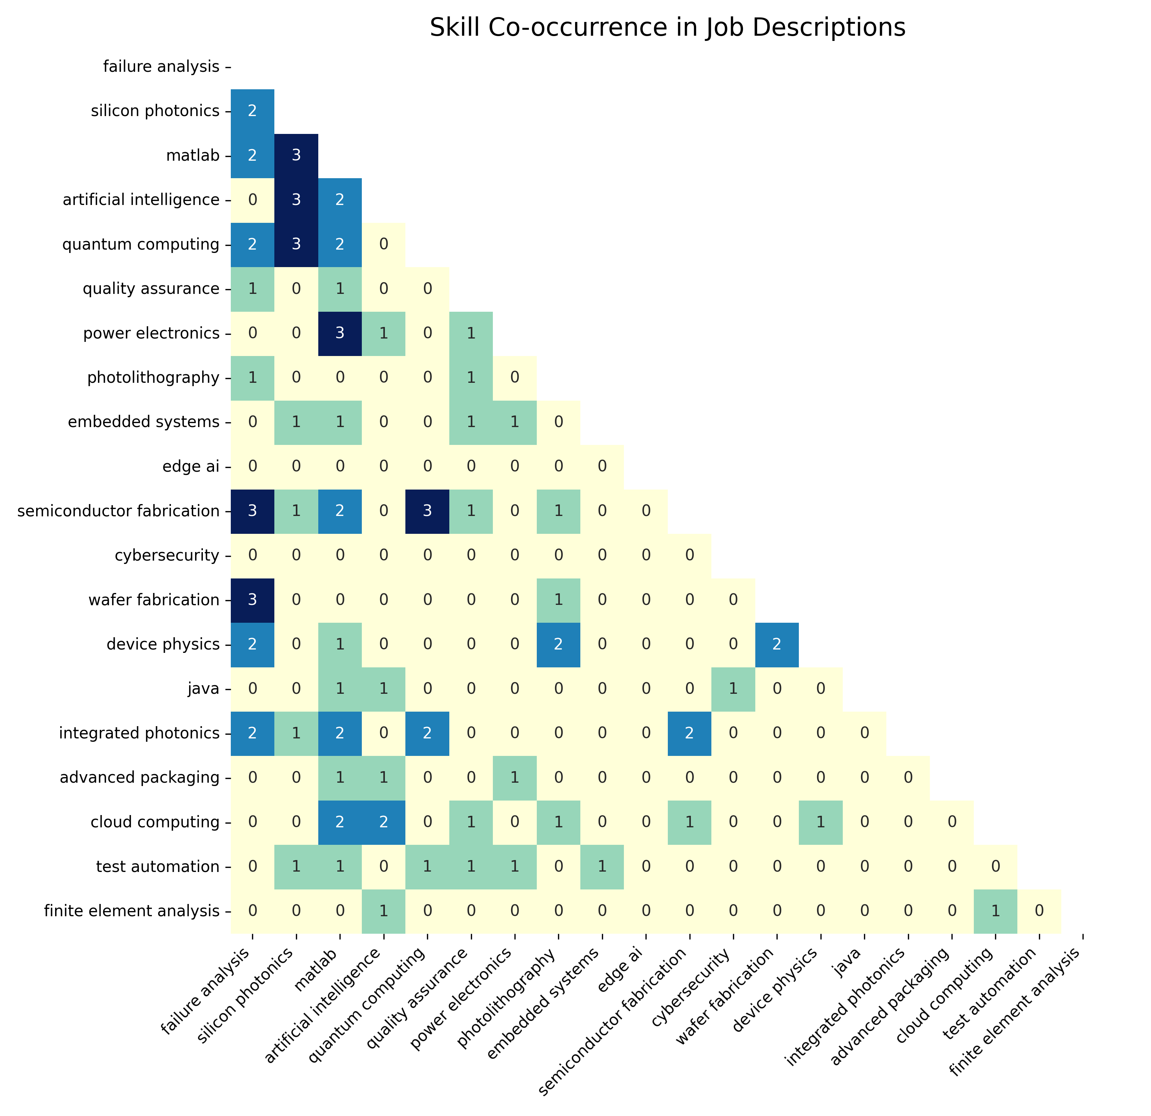
Co-occurrence Matrix
Heatmap of frequently co-mentioned skills

Slide 10
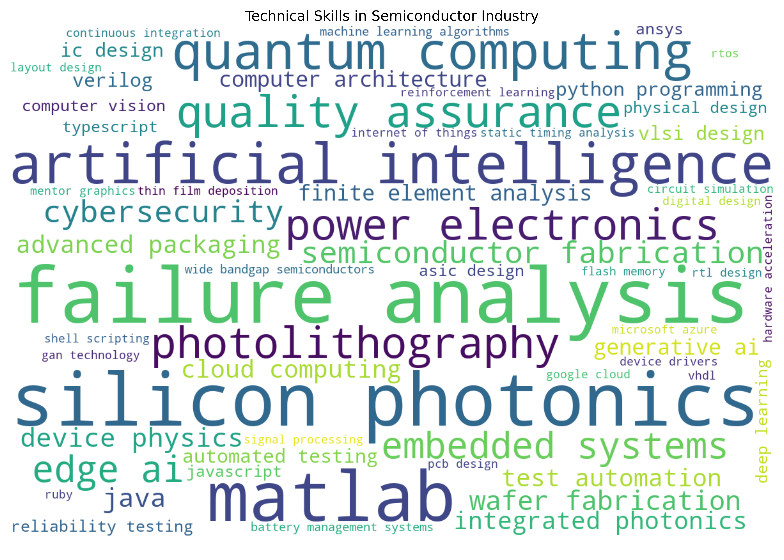
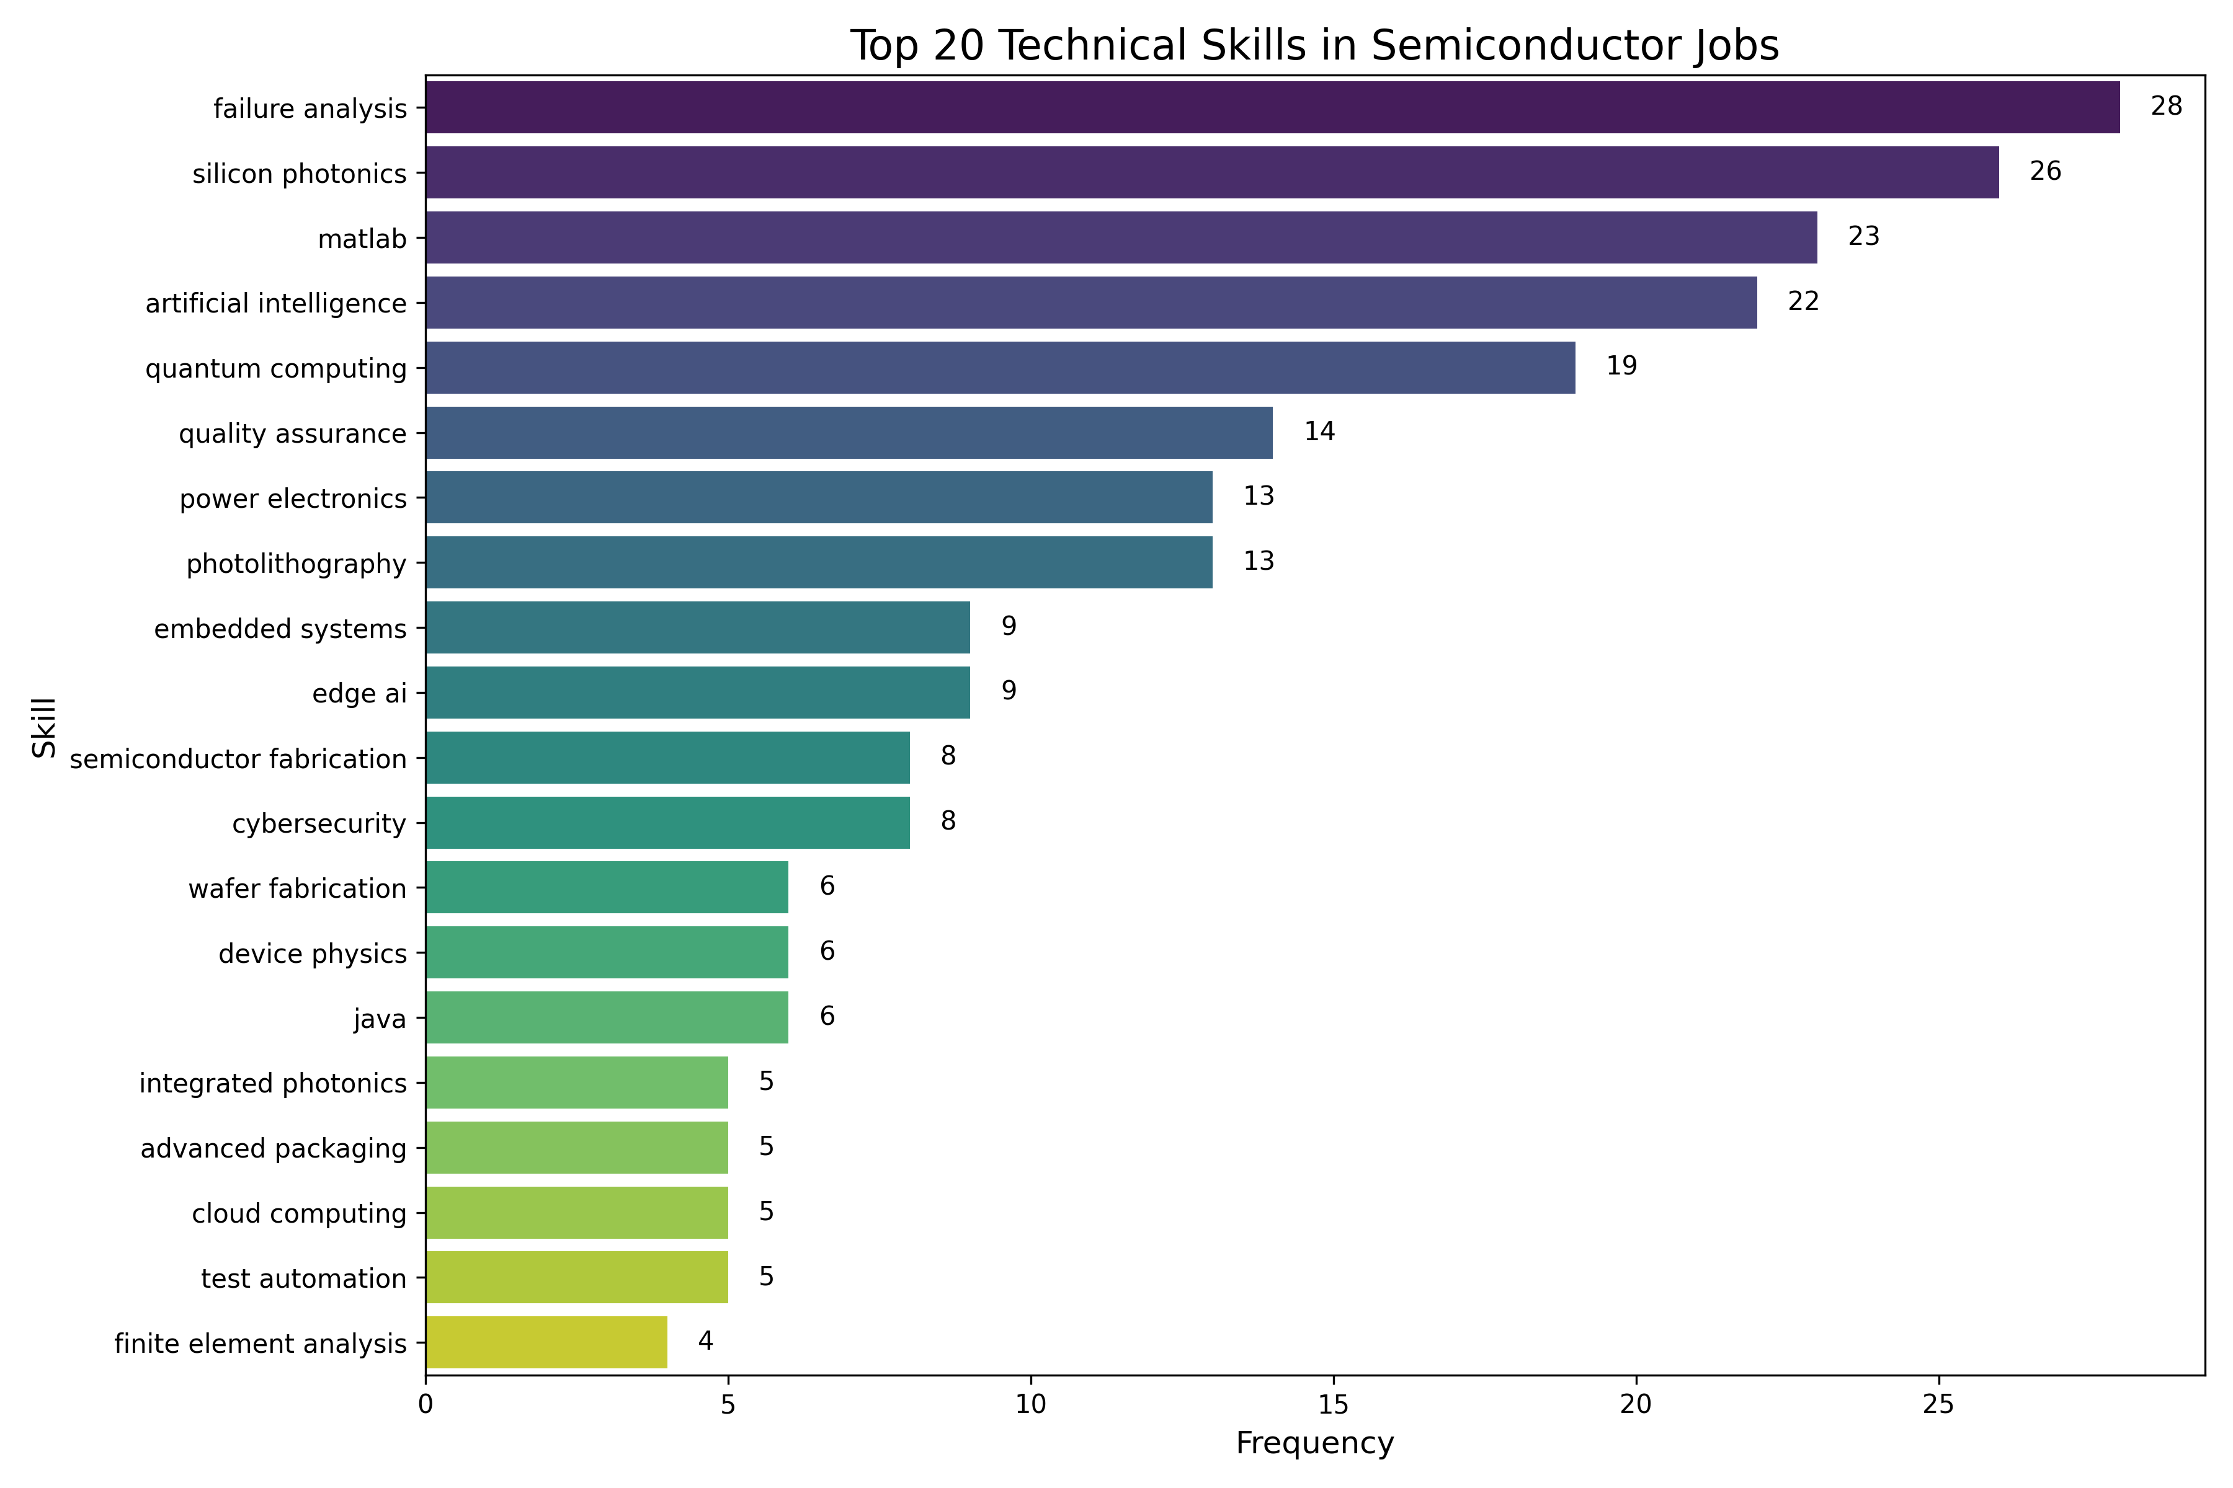
Word Cloud and Top Skills
Word cloud of extracted skills
Bar chart of top 20 skills

Slide 11
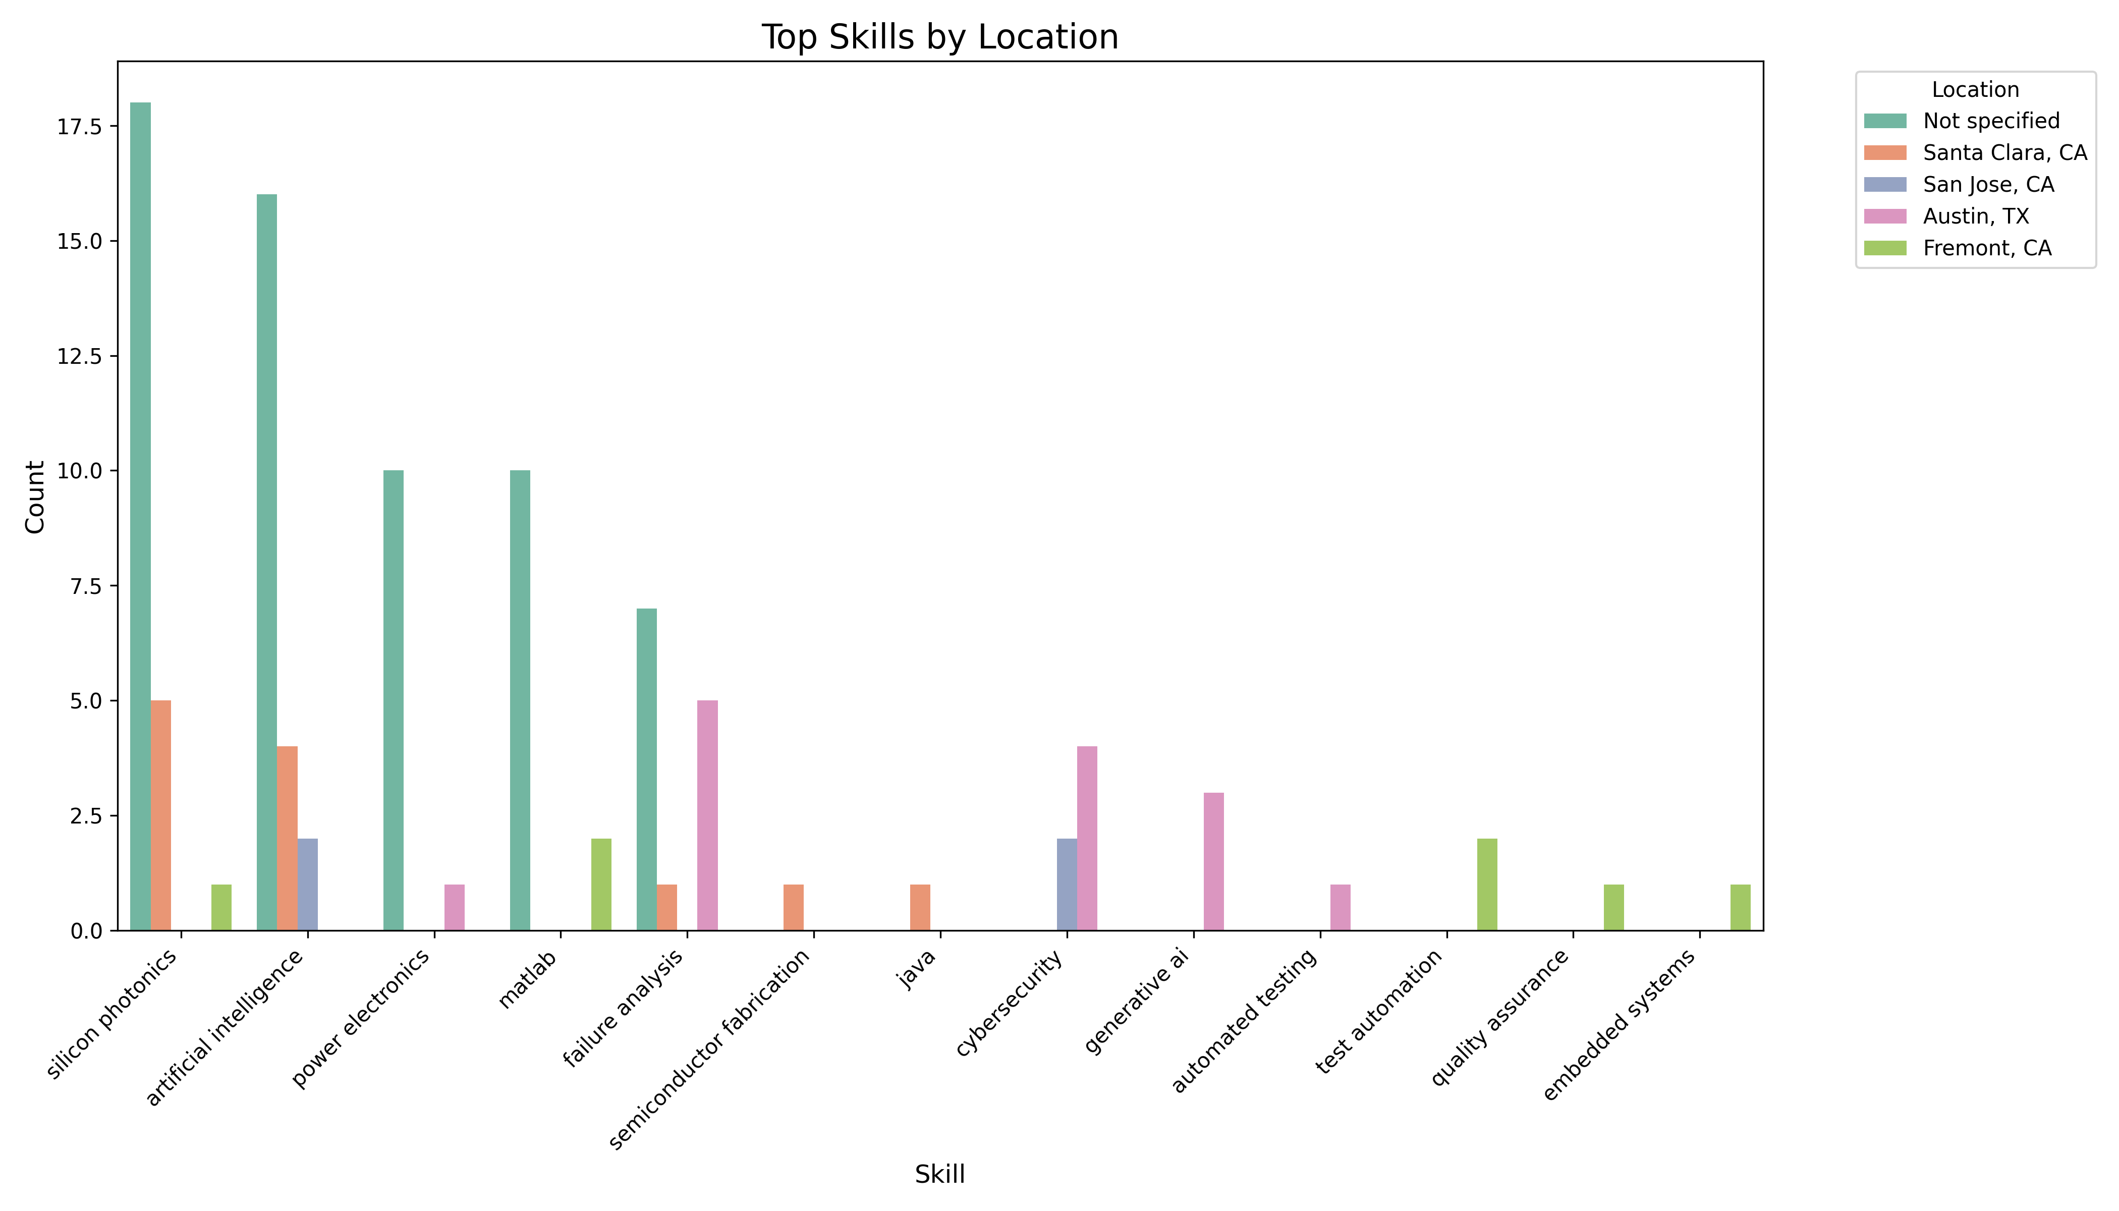
Geographic Variation in Technical Skill Demand

Slide 12
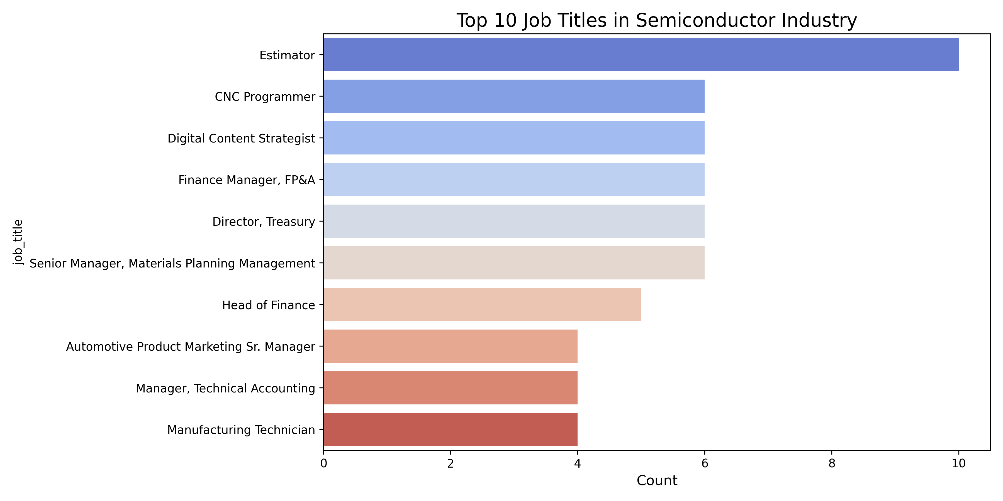
Most Common Roles in Semiconductor Job Postings

Slide 13
Key Insights
Top Emerging Skills:
Failure analysis, silicon photonics, AI, quantum computing, edge AI, matlab
Skill Category Leaders:
Digital Design, Verification, AI, Manufacturing
Regional Trends:
Austin: Cybersecurity, generative AI
Santa Clara: AI, silicon photonics
Fremont: Test automation, embedded systems
Role Trends:
Mix of technical and non-technical roles (e.g., estimators, finance managers)
Skill Pairings:
Skills like AI, photolithography, quantum computing frequently co-occur

Slide 14
Recommendations
For Job Seekers
Build cross-domain skills (e.g., hardware + AI)
Prioritize in-demand fields: verification, photonics, quantum tech
Target roles by region-specific demands
For Employers
Use location-specific data to guide recruiting
Build internal training across EDA, AI, and advanced materials
Foster mentorship across traditional and emerging domains
For Educators
Introduce AI-integrated semiconductor tracks
Incorporate hands-on training with industry-standard tools
Align curriculum with trending domains: verification, photonics, quantum

Slide 15
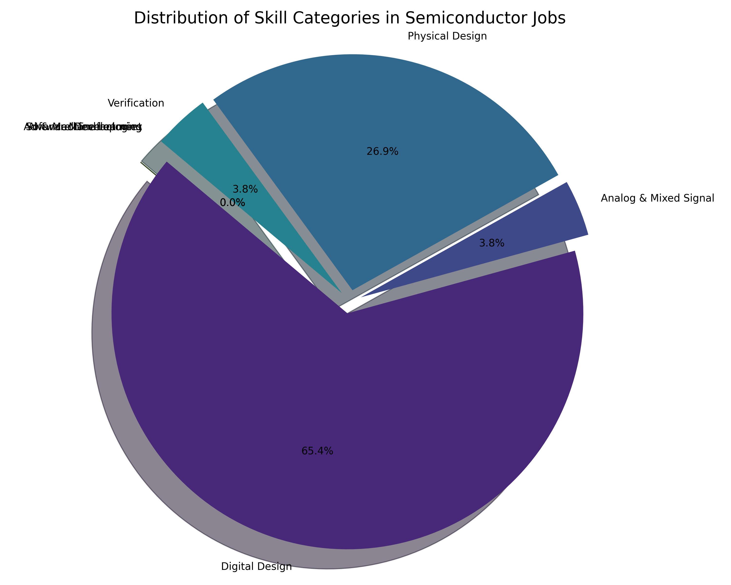
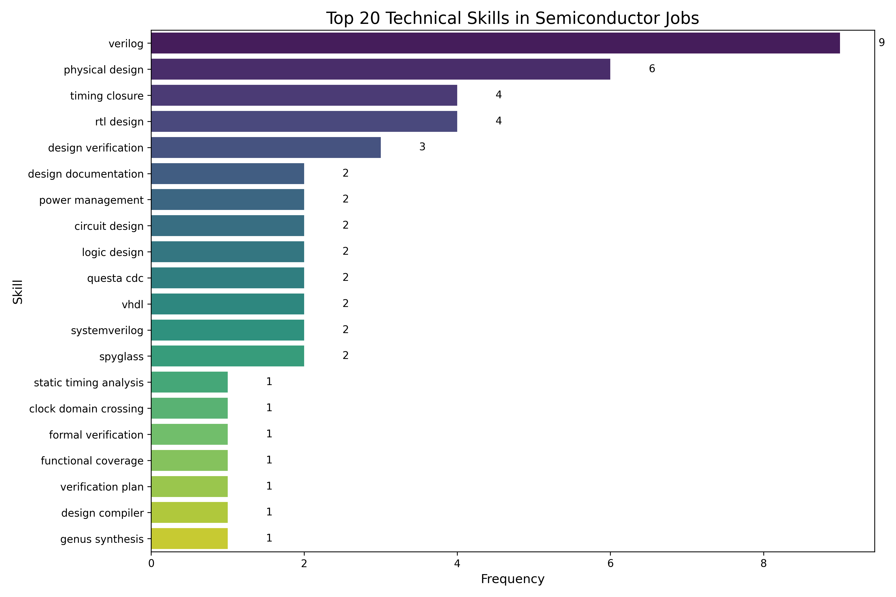
Specific about Design Roles

Slide 16
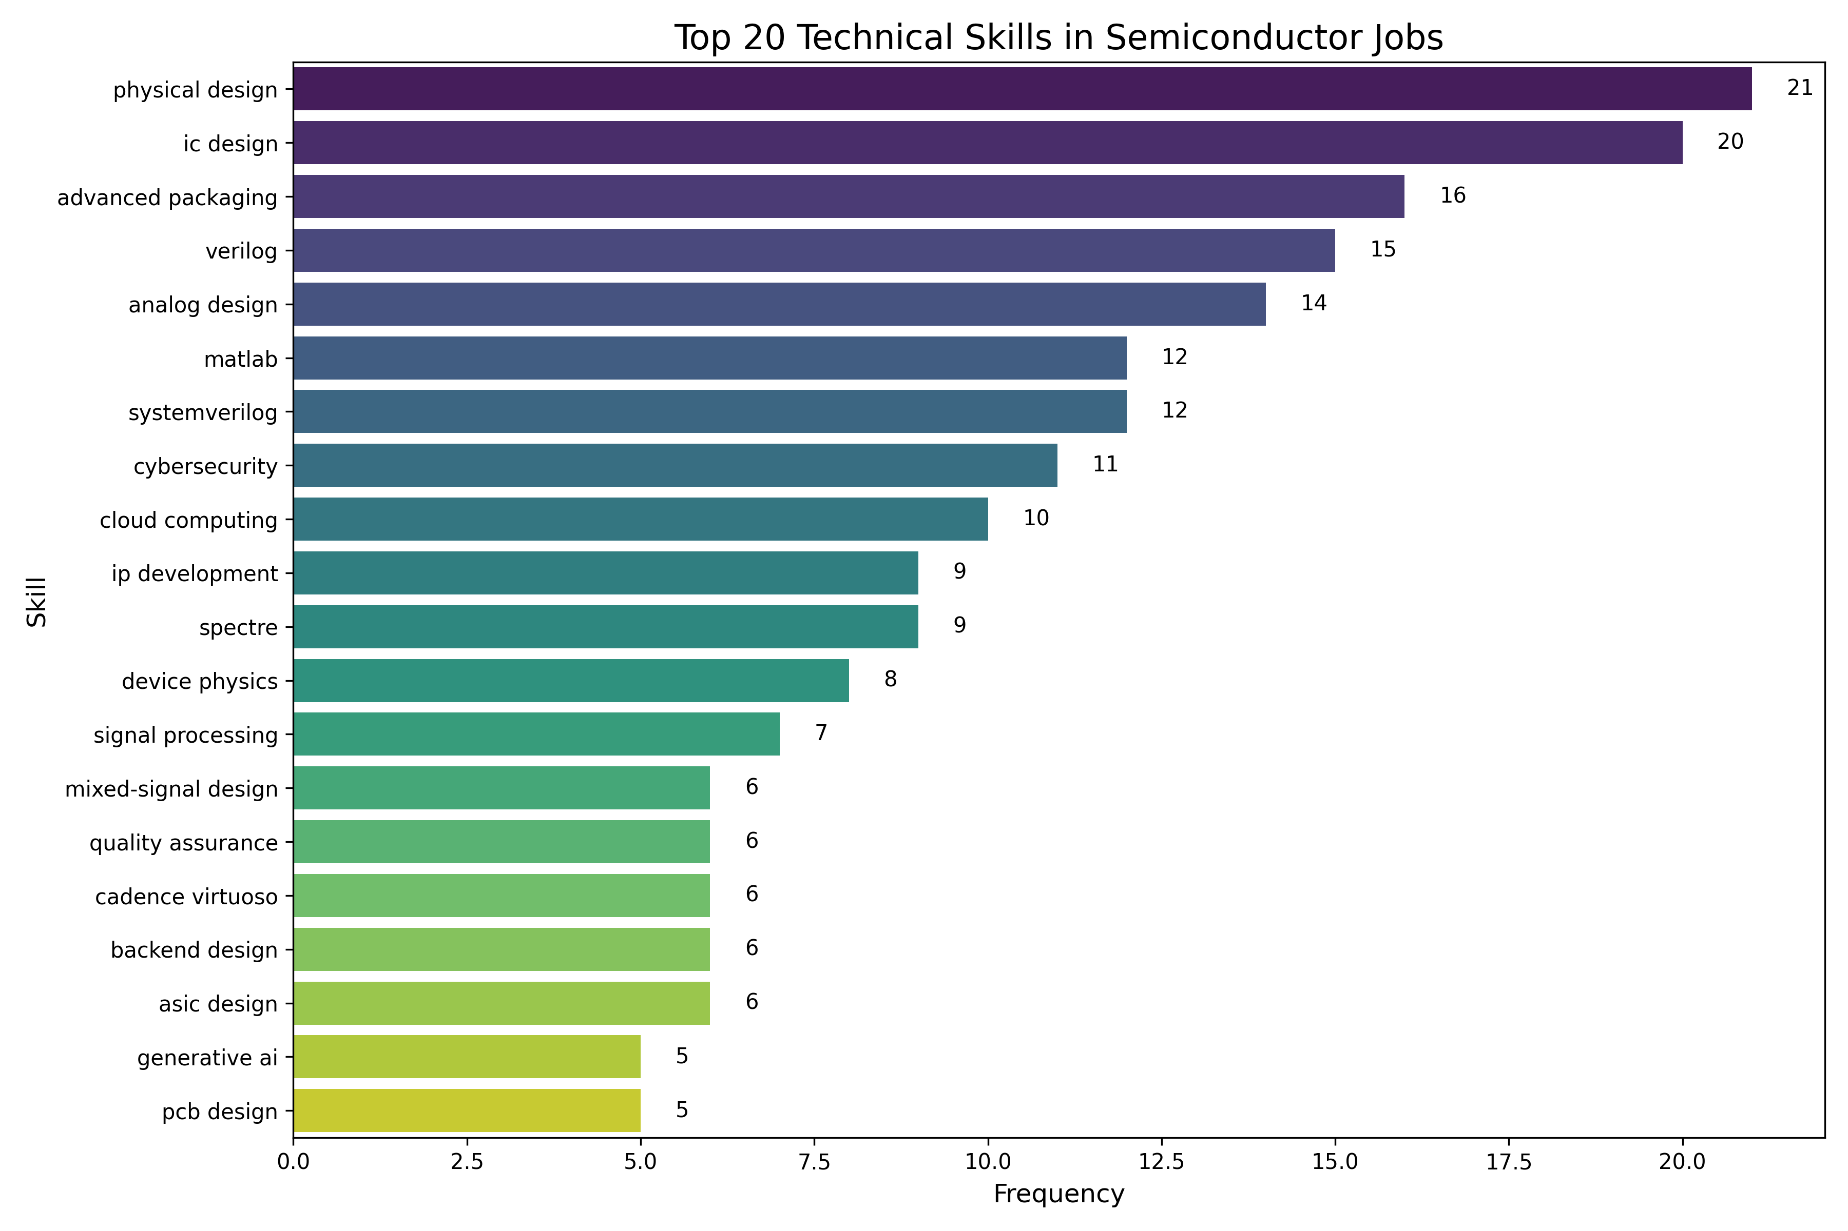
Comparison between Industry and Marvell
industry
marvell

Slide 17
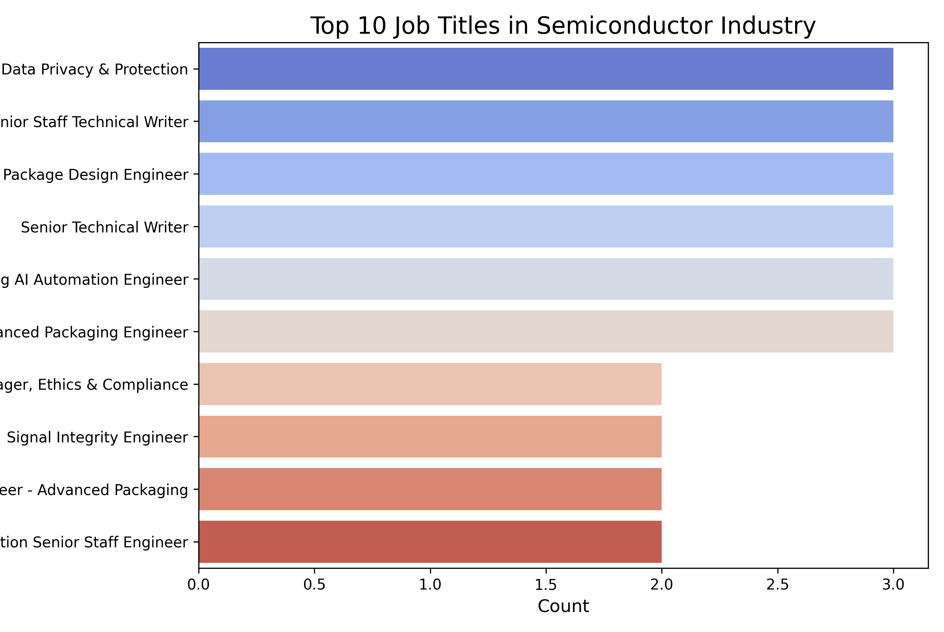
Comparison about job titles
marvell
industry

Slide 18
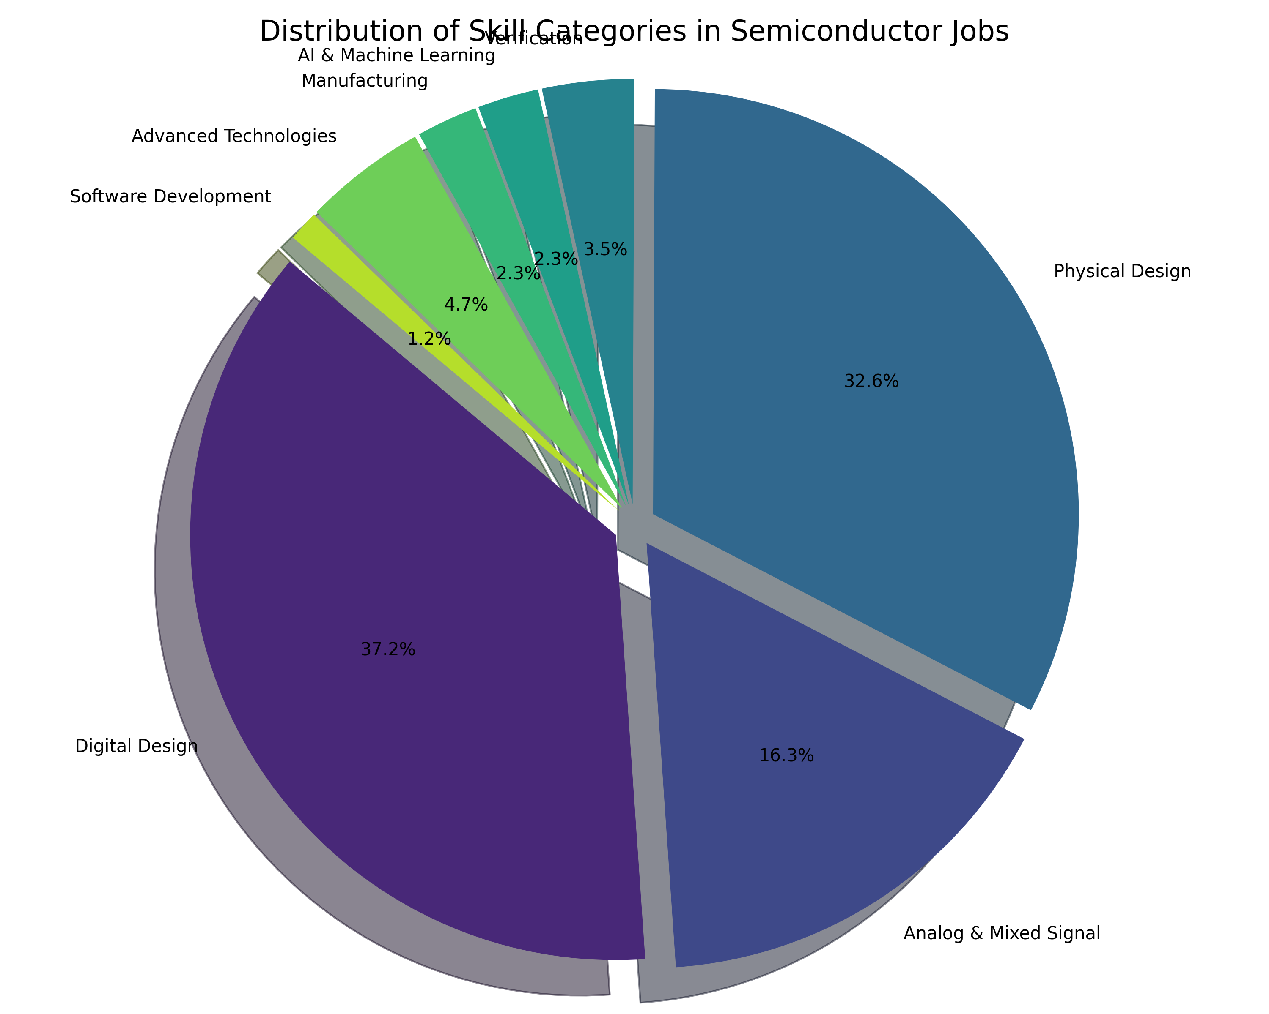
Comparison about skill categories
industry
marvell

